Slide 1
Standard Deduction Qualified Business Income Deduction
Pub 4012 – Tab F
Pub 4491 – Lesson 20

Slide 2
Lesson Topics
2019 Standard deduction
Additional amounts
Dependent standard deduction
When MFS must itemize
Qualified Business Income Deduction
Defined
How to calculate

Slide 3
Deductions
Subtractions from a taxpayer’s adjusted gross income (AGI)
Reduces amount of income taxed
Most taxpayers have a choice
Standard deduction
Itemizing deductions
Use deduction that results in lower tax

Slide 4
Standard Deduction
Standard deduction is a fixed reduction of AGI based on:
Filing status
Age (65 or older)
Blindness
Dependency
Standard amounts change each year
Automatically calculated based on TaxSlayer entries
4
Notes:
Check filing requirements for MFJ (JOINT) when couple did not live together at end of year. Standard deduction and filing requirements are NOT the same.

Slide 5
Standard Deduction
2019 standard deduction
Single or Married Filing Separately – $12,200
Married Filing Jointly or Qualifying Widow(er) – $24,400
Head of Household – $18,350
Additional amount for age or blindness
$1,650 for Single and HoH
$1,300 for MFJ, MFS and QW
Personal exemption deduction suspended for 2018 through 2025
Notes:
Check filing requirements for MFJ (JOINT) when couple did not live together at end of year. Standard deduction and filing requirements are NOT the same.

Slide 6
Blindness
Totally blind taxpayer or
Certified statement from eye doctor that
Taxpayer cannot see better than 20/200 in the better eye with glasses or contact lenses or
Field of vision not more than 20 degrees
Notes:
Not necessary for taxpayer to produce this certified statement – remind them of need to prove if asked and accept their verbal statement - it’s their return

Slide 7
When MFS Must Itemize
Filing as MFS
If either itemizes deduction – both must itemize
Does not matter who files first
Note: if taxpayer considered unmarried for Head of Household purposes, taxpayer may claim standard deduction even though spouse files MFS and itemizes
Notes:
MFS: If second to file chooses to itemize and first to file choose standard, first to file must amend his/her return to itemize deductions
7

Slide 8
Standard Deduction for Dependents
Pub 4012 Tab F
Dependent of another taxpayer
Standard deduction is $350 plus earned income
Minimum: $1,100
Maximum: the regular standard deduction amount
Plus $1,650 for 65 or older or blind Single or HoH ($1,300 if MFJ, MFS, QW)
If the person that could claim the dependent does not have to file (and does not file a return*), the “dependent” is not a dependent for all tax purposes and can use the normal standard deduction
*or files only to get a refund of withheld or estimated taxes
Notes:
Refer to Pub 4012 F-1 for the regular standard deduction amounts
Good worksheet in Pub 4012 this year for dependent’s standard deduction

Slide 9
Standard Deduction for Nonresident Aliens
Pub 519 Chapter 1
Dual status alien or a nonresident alien
May not be eligible for standard deduction
International certification required

Slide 10
Quality Review
Verify blind (and disability if relevant to your state) entries in Intake Booklet
Verify type of deduction if MFS
Verify dependent’s standard deduction amount

Slide 11
Qualified Business Income Deduction
Individual taxpayers can deduct up to 20% of qualified business income (QBI)
A deduction from AGI to arrive at taxable income
In addition to standard or itemized deductions
Also referred to as Section 199A deduction
TaxSlayer calculates QBI deduction on Form 8995 QBI Deduction Simplified Computation
Notes:
Also referred to as Section199A Business Income Deduction

Slide 12
Qualified Business Income
Schedule C income (combined if more than one)
Pass-through entity business income
Such as partnerships, S corporations, limited liability companies
All pass-through entities with business income are out of scope
Real Estate Investment Trust (REIT) 199A dividends
Scope: if taxable income (before the QBI deduction) exceeds $160,725 ($321,400 if MFJ) the return is out of scope
Special rules apply if threshold is exceeded – out of scope
Notes:
New box 5 1099-DIV for section 199A dividends eligible for QBI

Slide 13
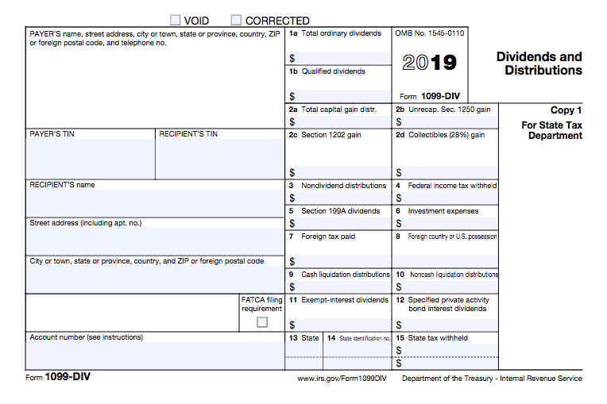
REIT and Qualified Business Income
Notes:
Box 5 eligible for QBI deduction

Slide 14
QBI Deduction Implications
Qualified Business Income Deduction does not reduce
Schedule C income
Self-employed health insurance deduction
IRA deduction
Schedule SE tax and ½ SE tax adjustment
Qualified Business Income is reduced by
Self-employed health insurance deduction
½ SE tax adjustment

Slide 15
Calculating QBI
Pub 4012 Tab F
20% of the lesser of
Calculated qualified business income
Schedule C profit (as shown on all Schedule C)
Plus qualified REIT dividends (section 199A dividends)
Minus adjustment for ½ Self-Employment tax
Minus SE health insurance deduction (if applicable)
Taxable income in excess of any net capital gain* and before the QBI deduction
* The term “net capital gain” means the excess of the net long-term capital gain for the taxable year over the net short-term capital loss for such year increased by qualified dividends
Notes:
See Pub 4012 Tab F for TaxSlayer entries

Slide 16
QBI Deduction Example 1 without Capital Gain
2019 calculated Qualified Business Income $7,865
$10,000 Schedule C profit – $707 Deductible portion of SE tax – $1,608 SE health insurance deduction
2019 taxable income (before QBI deduction) $8,100
QBI deduction is 20% of the lesser of:
$7,865 Calculated Qualified Business Income or
$8,100 Taxable income (before the QBI deduction)
$7,865 X 20% = $1,537
Notes:
Also referred to as Section199A Business Income Deduction

Slide 17
QBI Deduction Example 2 with Capital Gain
2019 calculated Qualified Business Income $7,865 (see previous slide)
2019 taxable income (before QBI deduction) $8,100
$700 of $8,100 is net capital gain income (includes qualified dividends)
QBI deduction is 20% of the lesser of
$7,865 Calculated Qualified Business Income or
$7,400 Taxable income (before QBI deduction) in excess of net capital gain income ($8,100 - $700 = $7,400)
$7,400 X 20% = $1,480
Notes:
Also referred to as Section199A Business Income Deduction
Remember: Subtract net capital gain from taxable income before calculating QBI deduction (TaxSlayer will calculate – Form 8995)

Slide 18
QBI Deduction Quality Review
Review for Qualified Business Income (Schedule C)
Review Form 1099-DIV for section 199A dividends
Confirm Form 1040 Qualified Business Income Deduction calculation
Form 8995 QBI Deduction Simplified Computation
Verify Qualified Business Income threshold not exceeded

Slide 19
QBI Deduction

